Slide 1
Link Stealing Attacks on Inductive
Trained Graph Neural Networks
Bachelor Thesis Introduction - Philipp Zimmermann

Slide 2
Graphs

Slide 3
Graphs
Datastructure
  Model large data and relationships between entities
  Nodes with features
  Edges

Slide 4
Graphs
Datastructure
  Model large data and relationships between entities
  Nodes with features
  Edges
Chemical Networks
  Protein-Protein Interactions

Slide 5
Graphs
Datastructure
  Model large data and relationships between entities
  Nodes with features
  Edges
Chemical Networks
  Protein-Protein Interactions
Social Networks
  Instagram
  Facebook
  Twitter

Slide 6
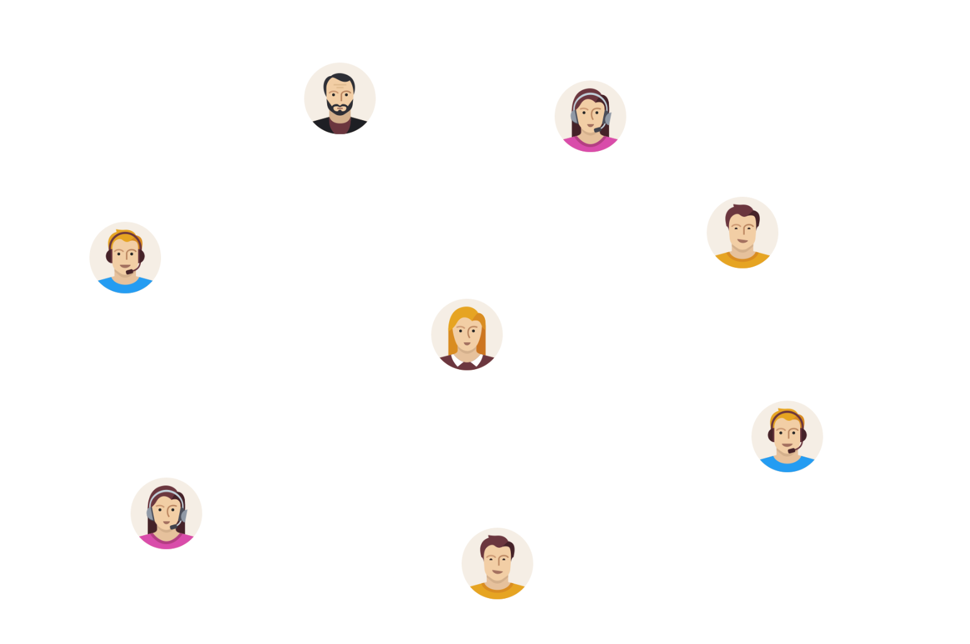
Graphs
Datastructure
  Model large data and relationships between entities
  Nodes with features
  Edges
Chemical Networks
  Protein-Protein Interactions
Social Networks
  Instagram
  Facebook
  Twitter

Slide 7
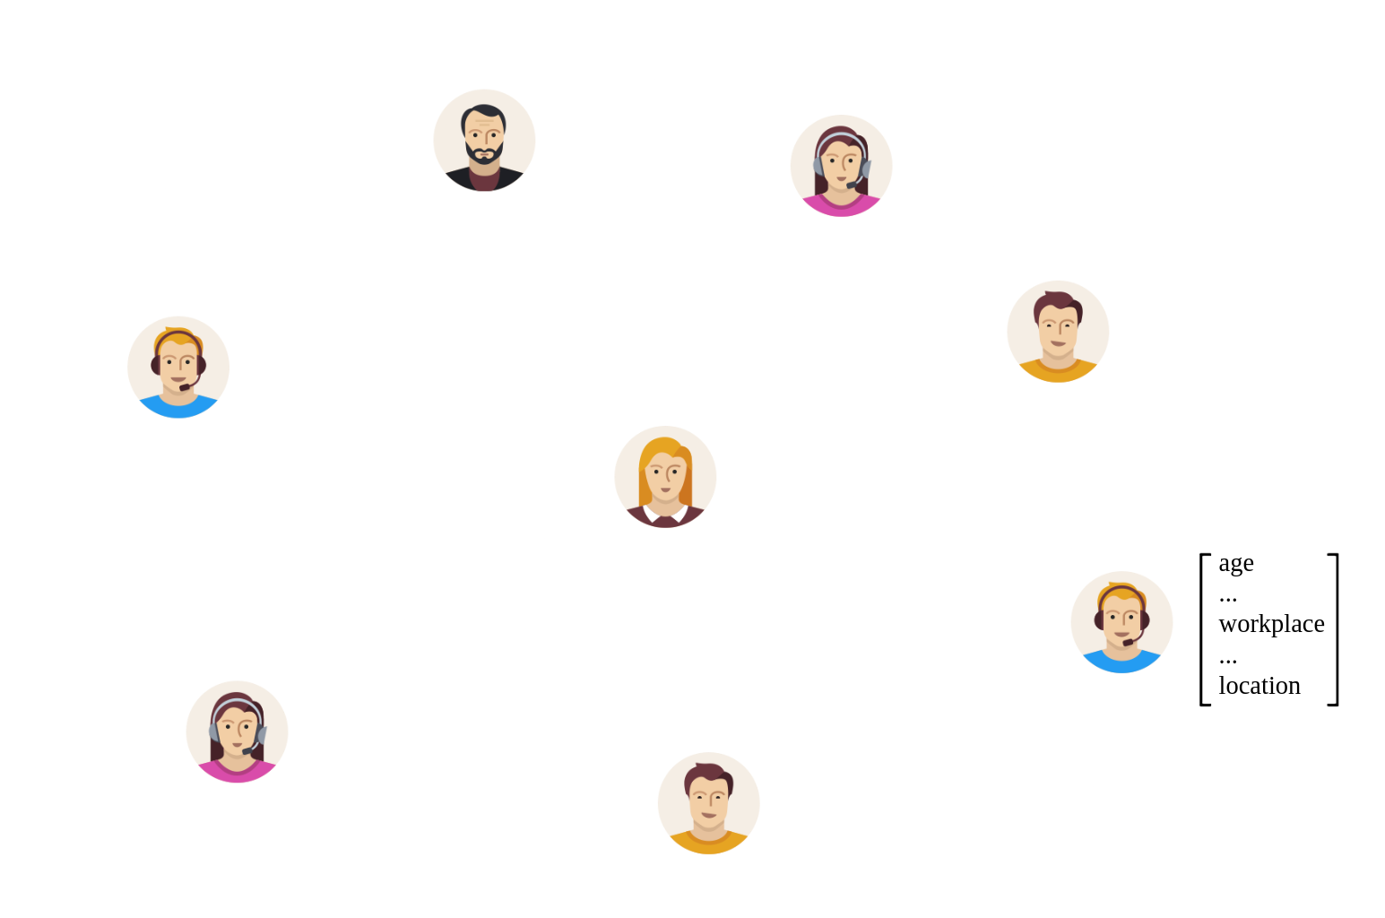
Graphs
Datastructure
  Model large data and relationships between entities
  Nodes with features
  Edges
Chemical Networks
  Protein-Protein Interactions
Social Networks
  Instagram
  Facebook
  Twitter

Slide 8
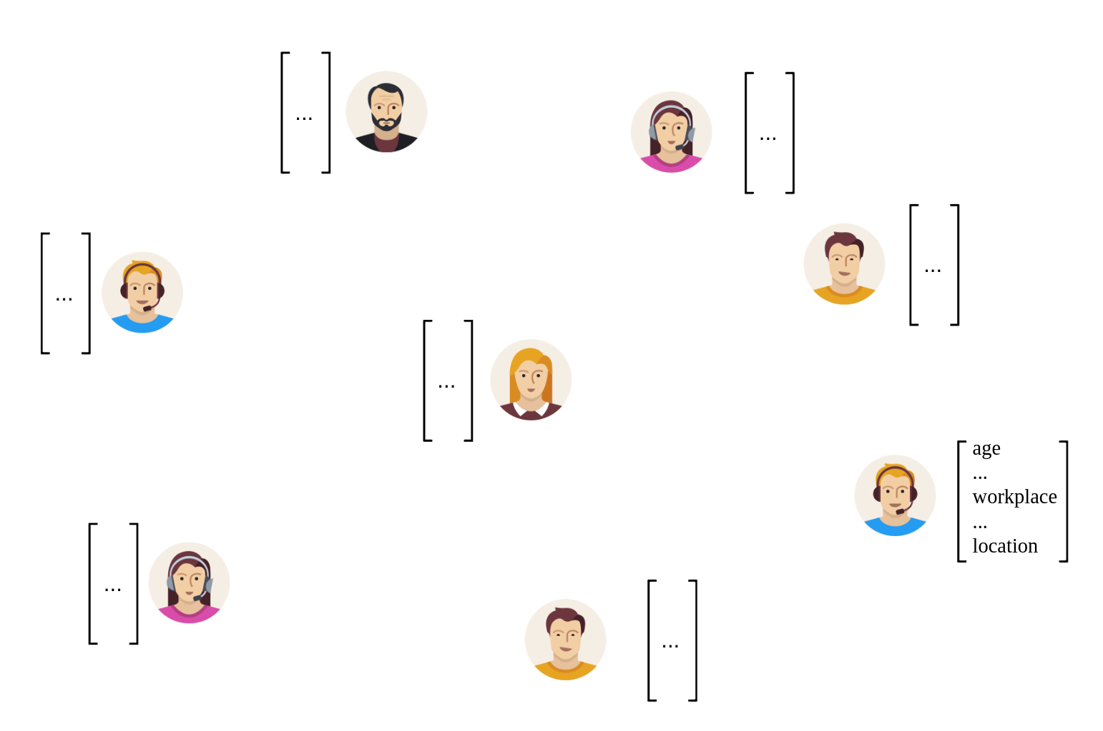
Graphs
Datastructure
  Model large data and relationships between entities
  Nodes with features
  Edges
Chemical Networks
  Protein-Protein Interactions
Social Networks
  Instagram
  Facebook
  Twitter

Slide 9
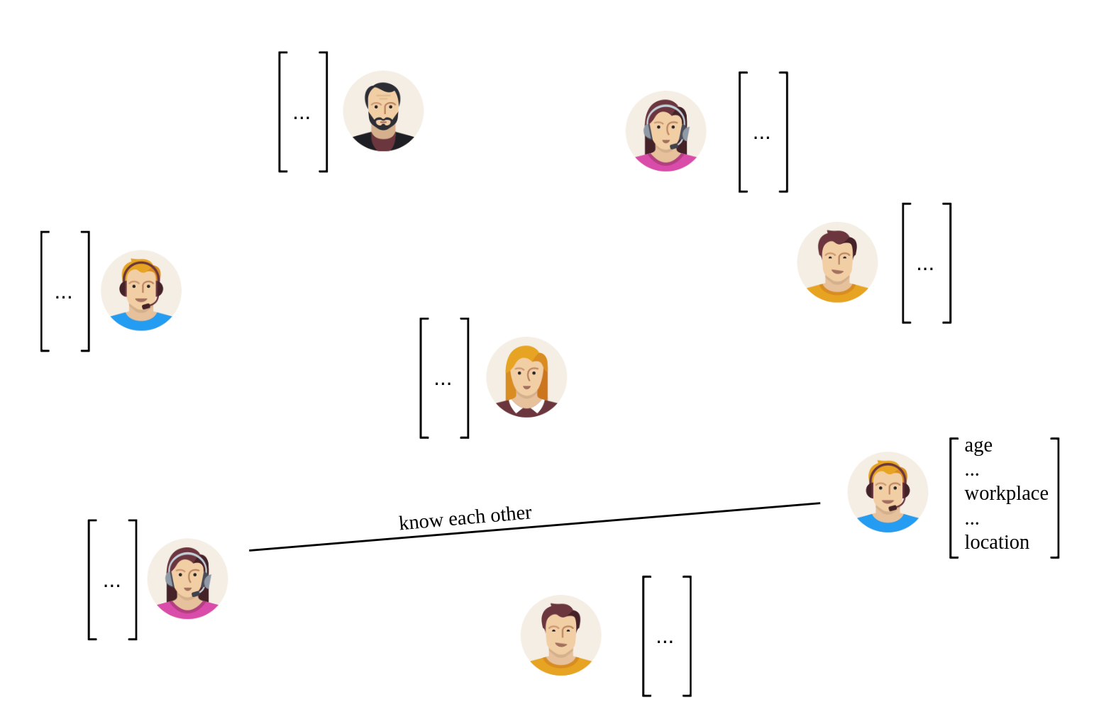
Graphs
Datastructure
  Model large data and relationships between entities
  Nodes with features
  Edges
Chemical Networks
  Protein-Protein Interactions
Social Networks
  Instagram
  Facebook
  Twitter

Slide 10
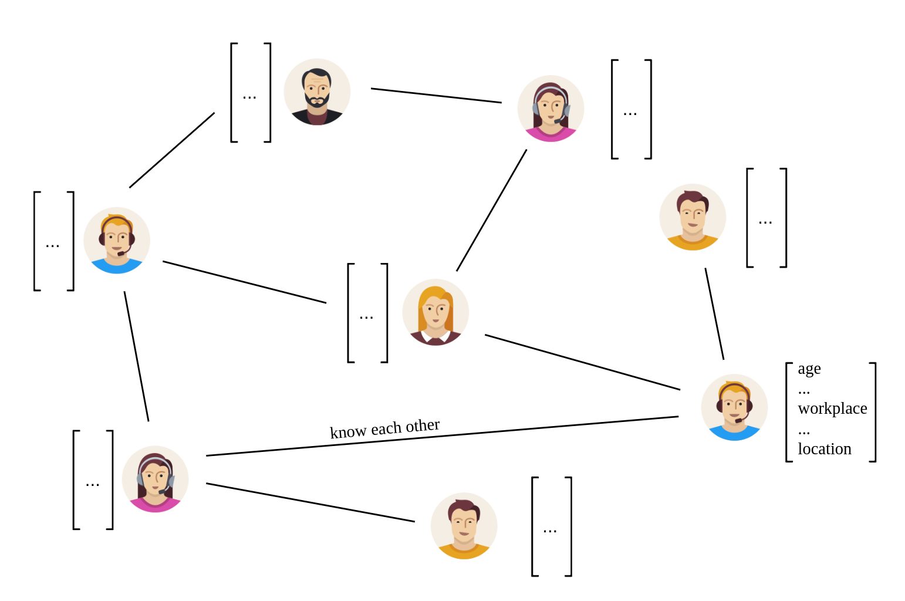
Graphs
Datastructure
  Model large data and relationships between entities
  Nodes with features
  Edges
Chemical Networks
  Protein-Protein Interactions
Social Networks
  Instagram
  Facebook
  Twitter

Slide 11
Graph Neural Networks (GNNs)

Slide 12
Graph Neural Networks
Machine Learning Models that operate on graphs
Different tasks
  Node Classification
  Graph Classification
  Link Prediction
Different learning methods
  Transductive
  Inductive

Slide 13
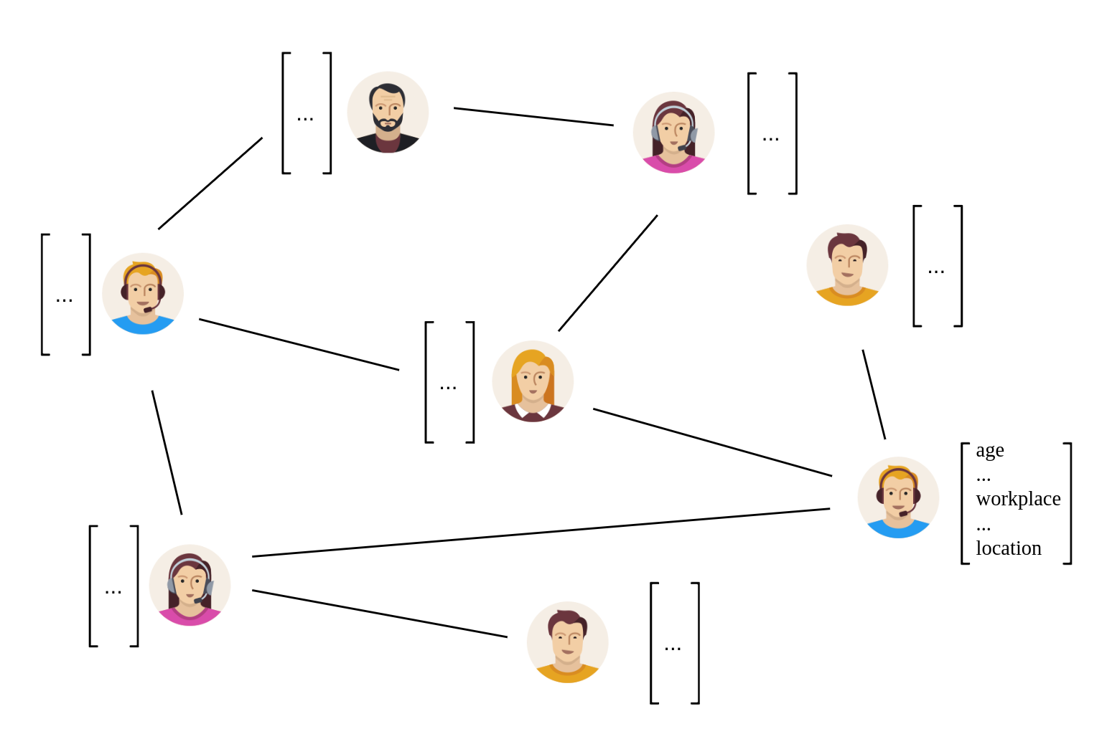
Graph Neural Networks
Transductive

Slide 14

Graph Neural Networks
Transductive

Slide 15
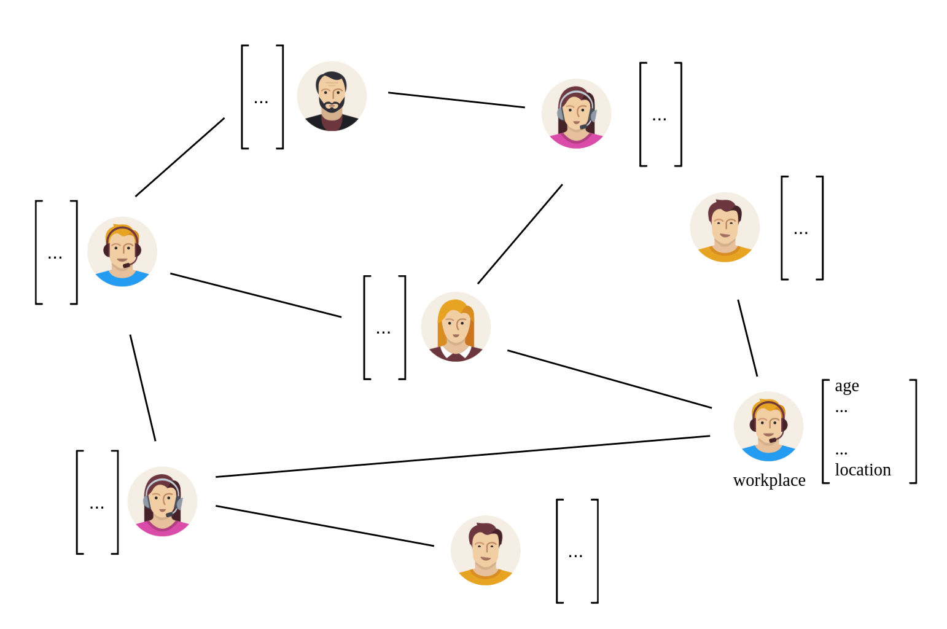
Graph Neural Networks
Transductive

Slide 16
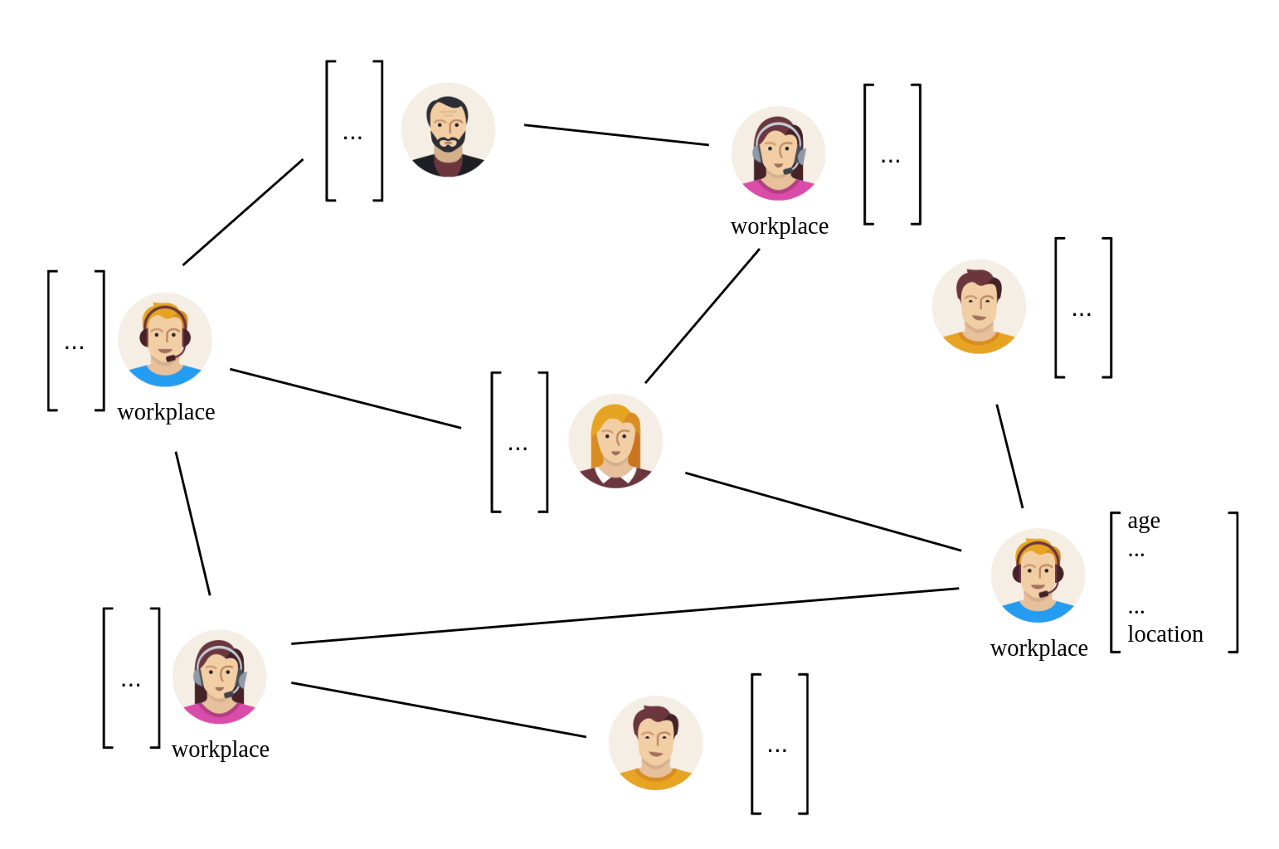
Graph Neural Networks
Transductive

Slide 17
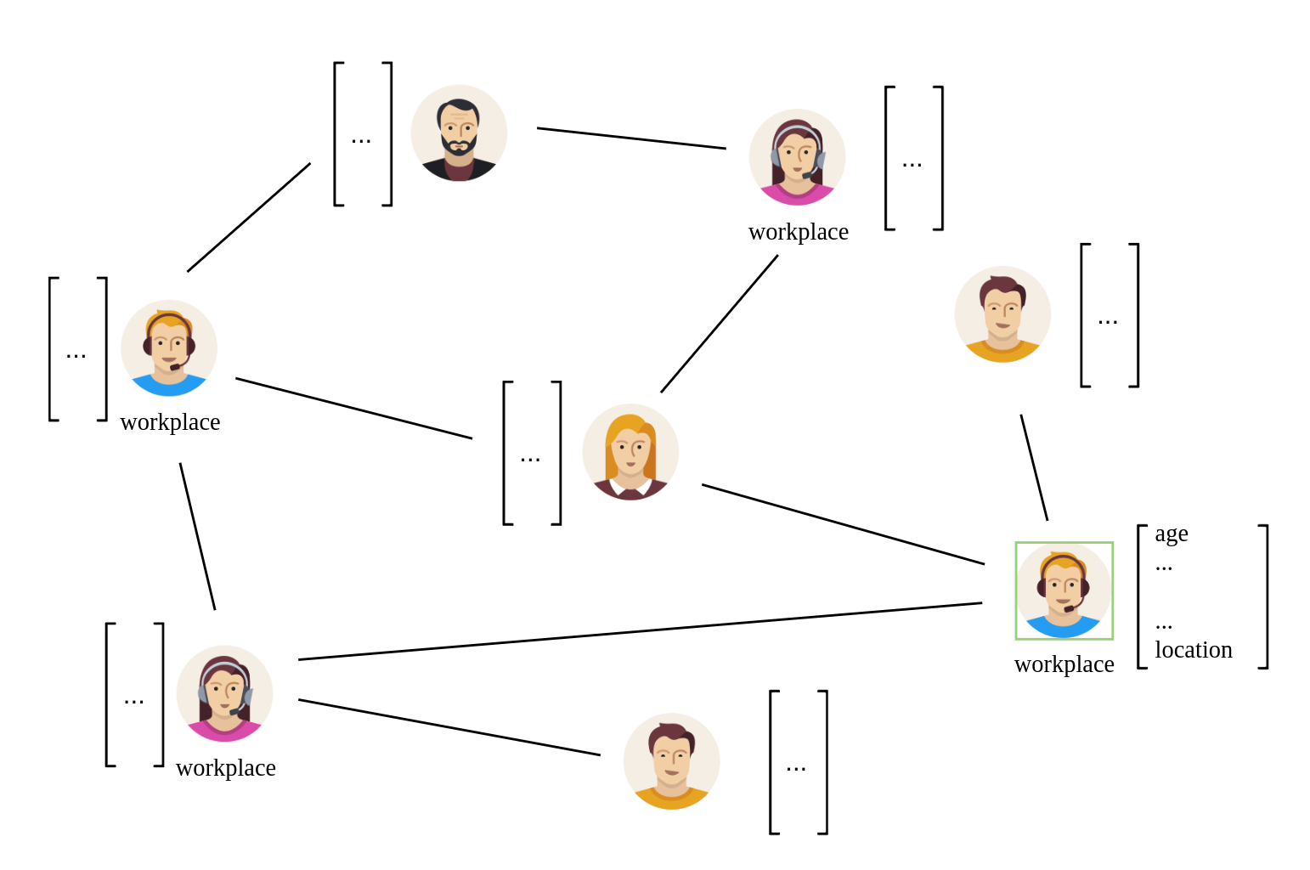
Graph Neural Networks
Transductive

Slide 18
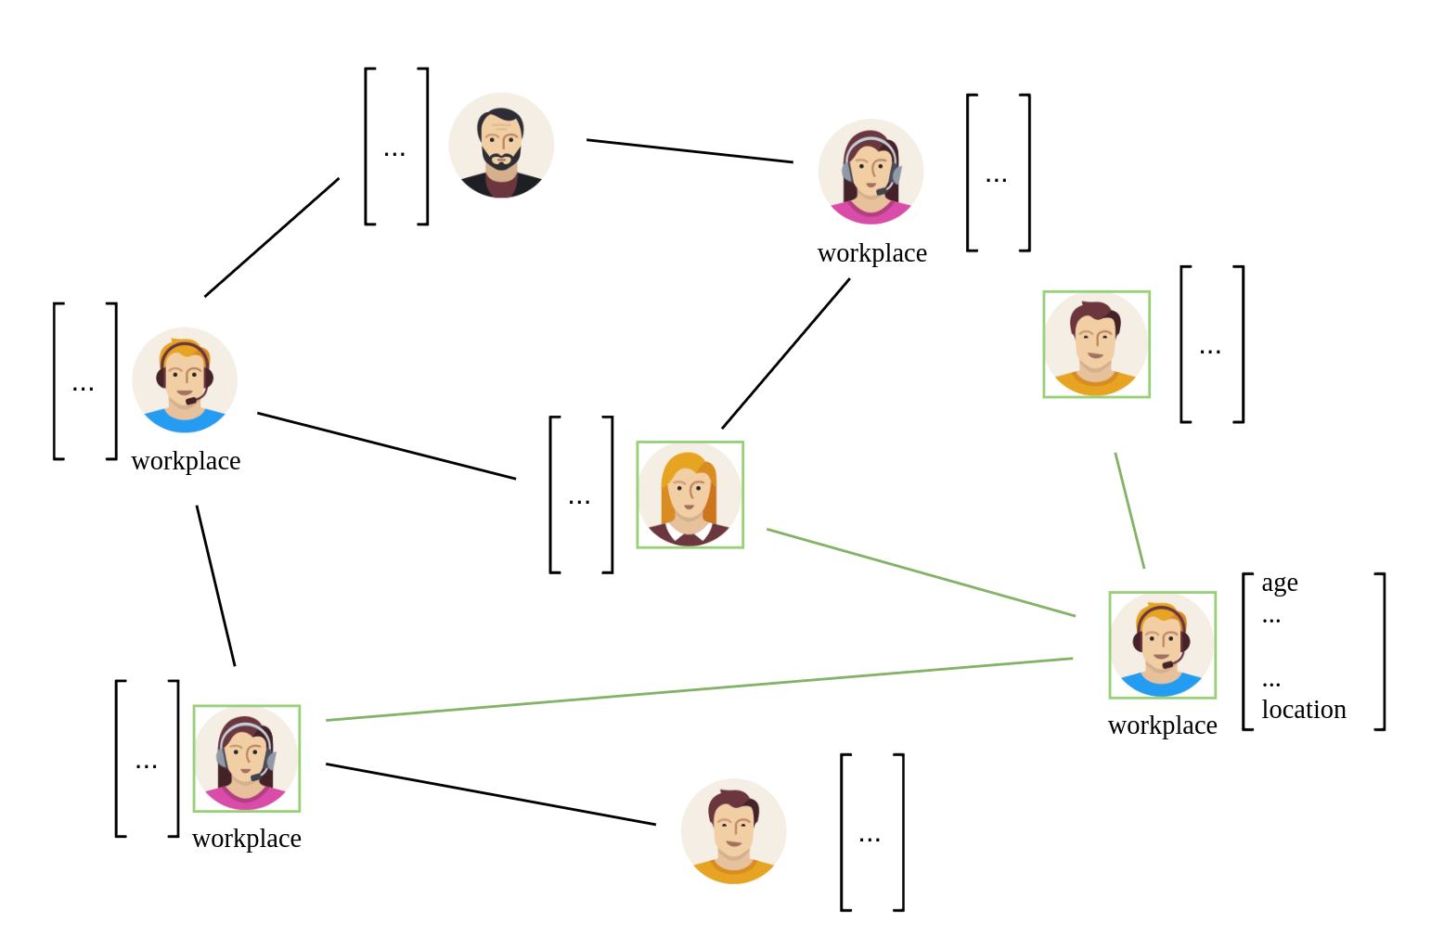
Graph Neural Networks
Transductive

Slide 19
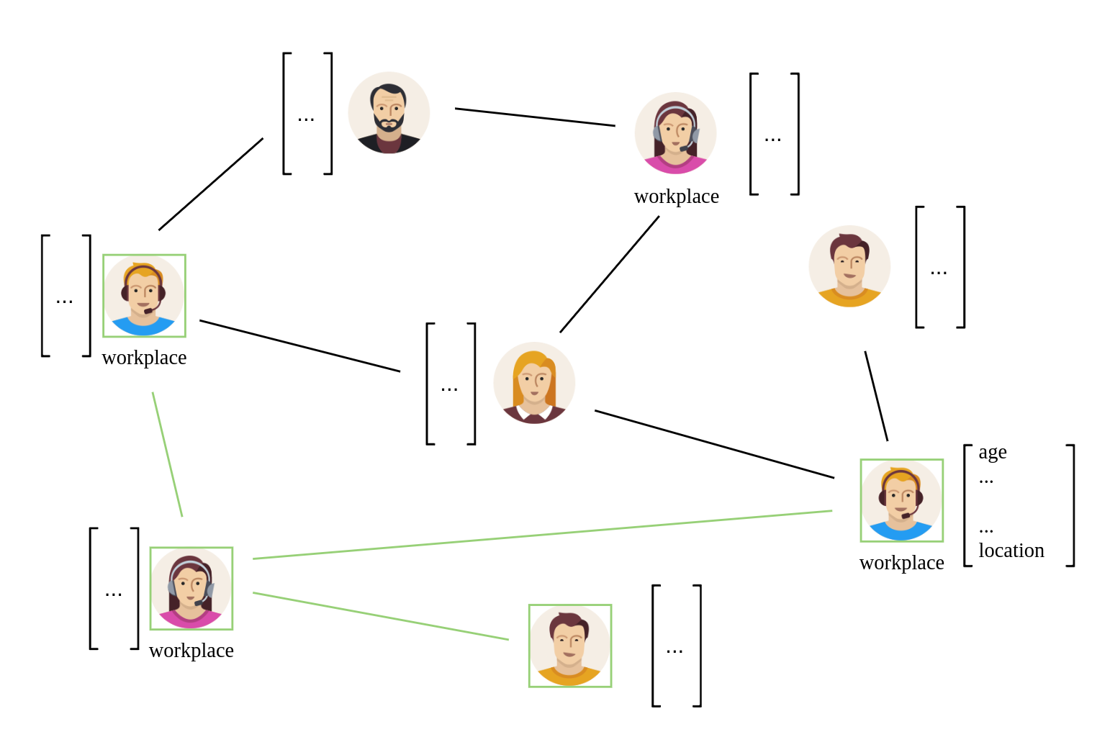
Graph Neural Networks
Transductive

Slide 20
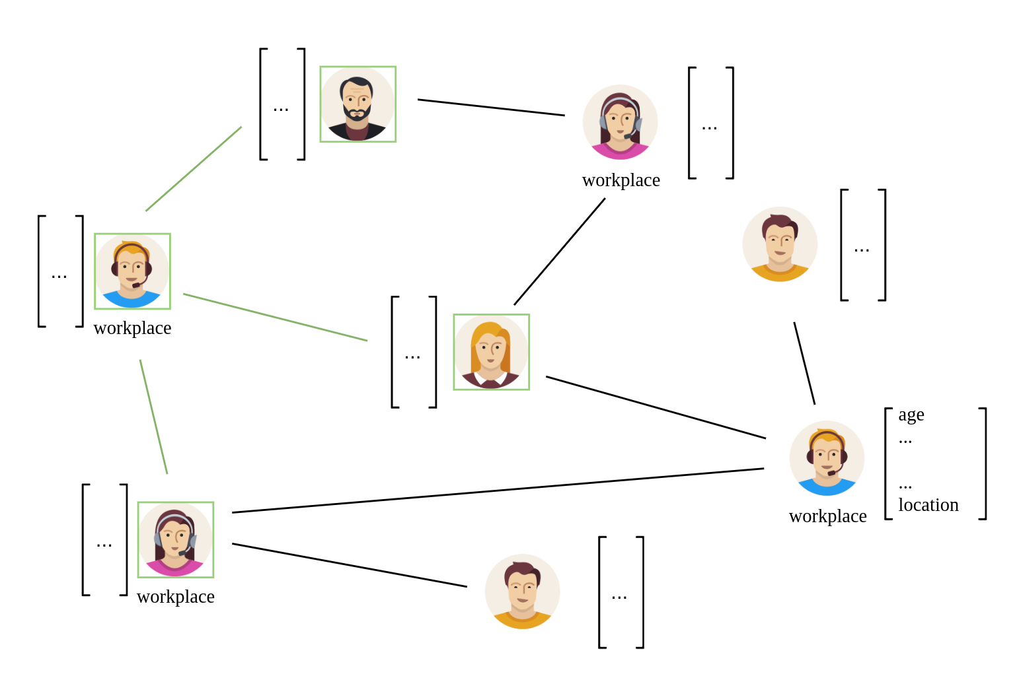
Graph Neural Networks
Transductive

Slide 21
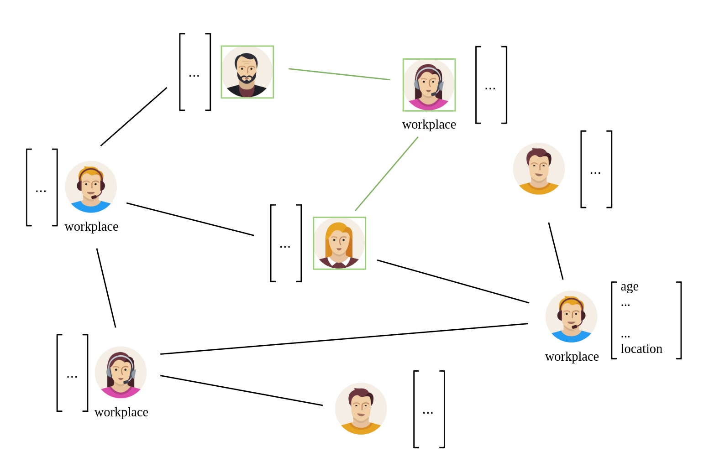
Graph Neural Networks
Transductive

Slide 22
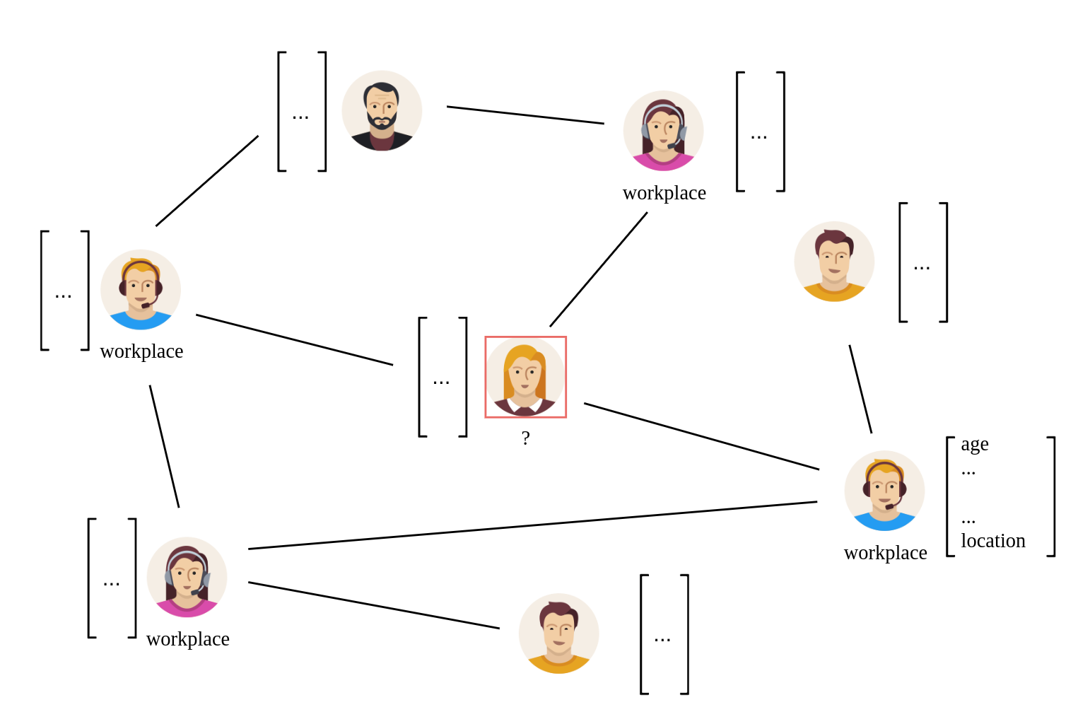
Graph Neural Networks
Transductive

Slide 23
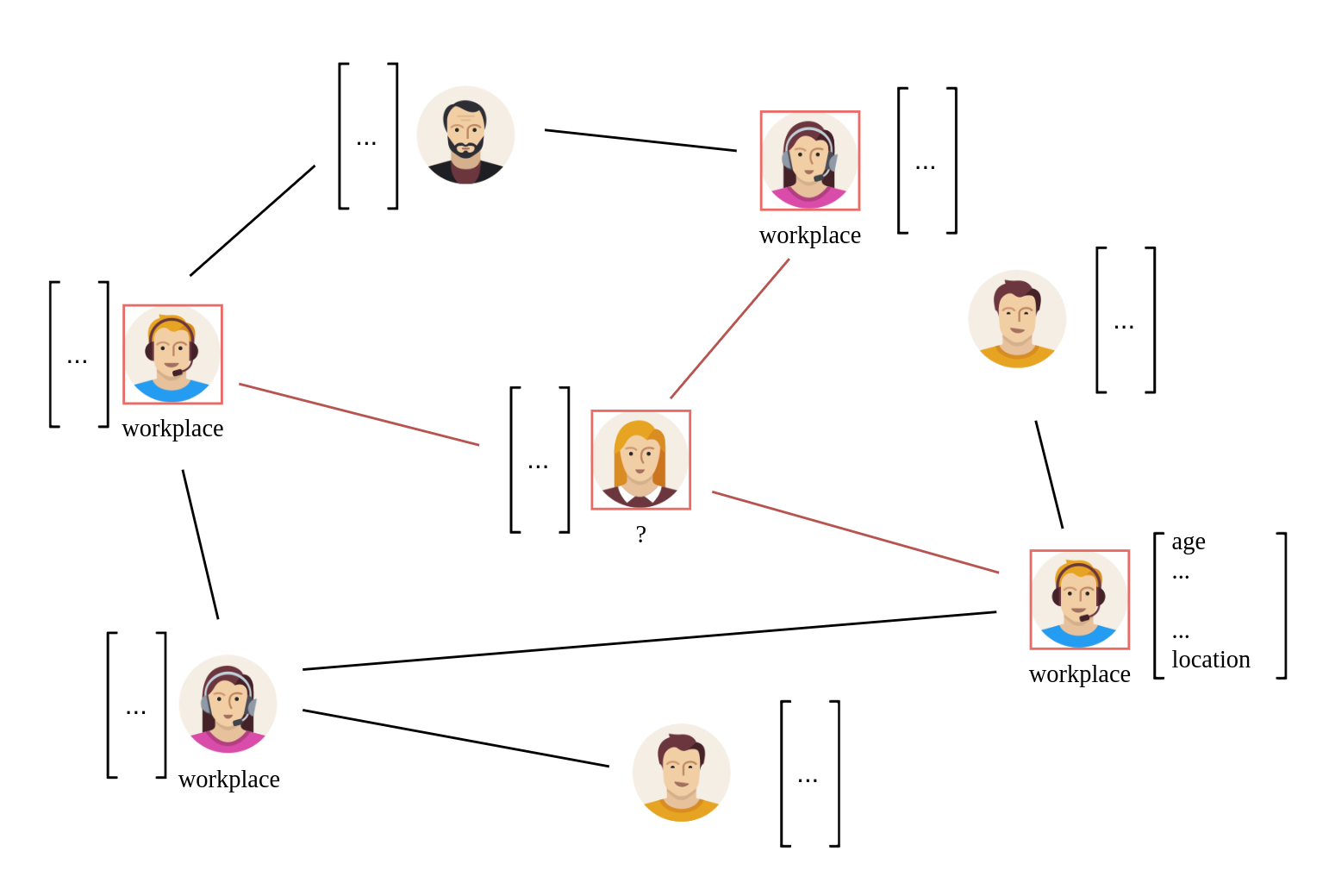
Graph Neural Networks
Transductive

Slide 24
Graph Neural Networks
Transductive
  Test set ( nodes and their features ) known during training
  Only label is unknown
  No realistic scenario

Slide 25
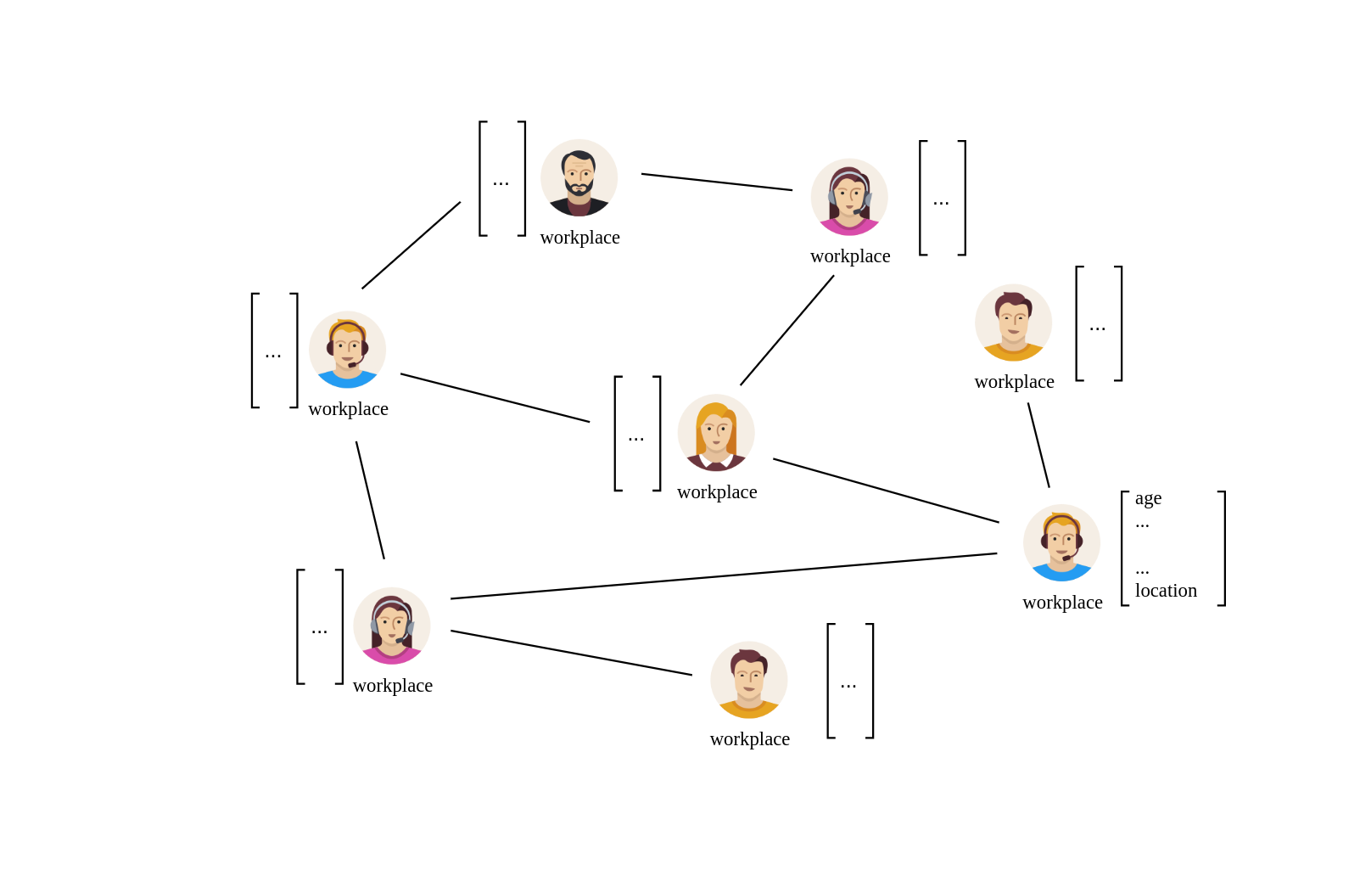
Graph Neural Networks
Inductive

Slide 26
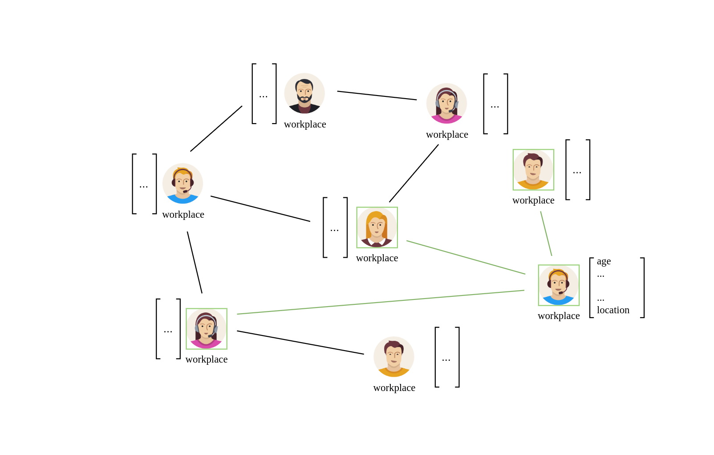
Graph Neural Networks
Inductive

Slide 27
Graph Neural Networks
Inductive

Slide 28
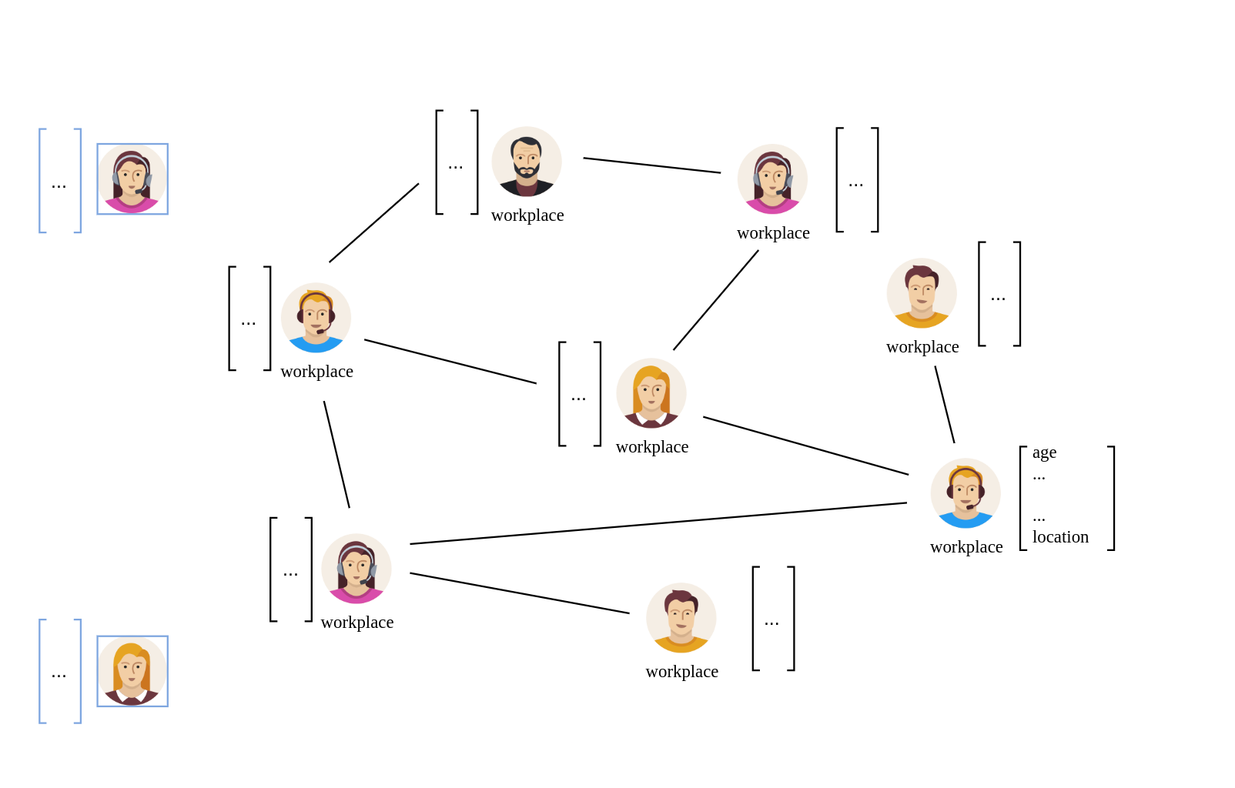
Graph Neural Networks
Inductive

Slide 29
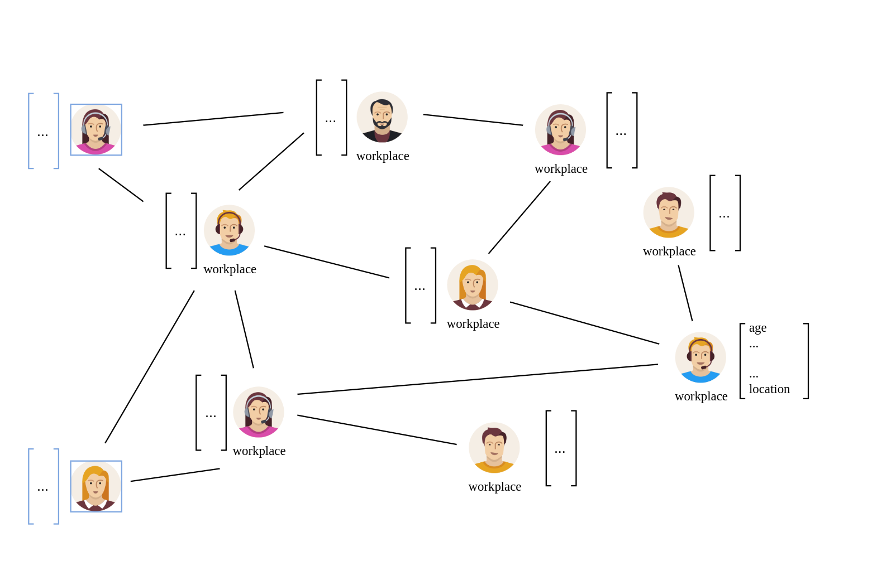
Graph Neural Networks
Inductive

Slide 30
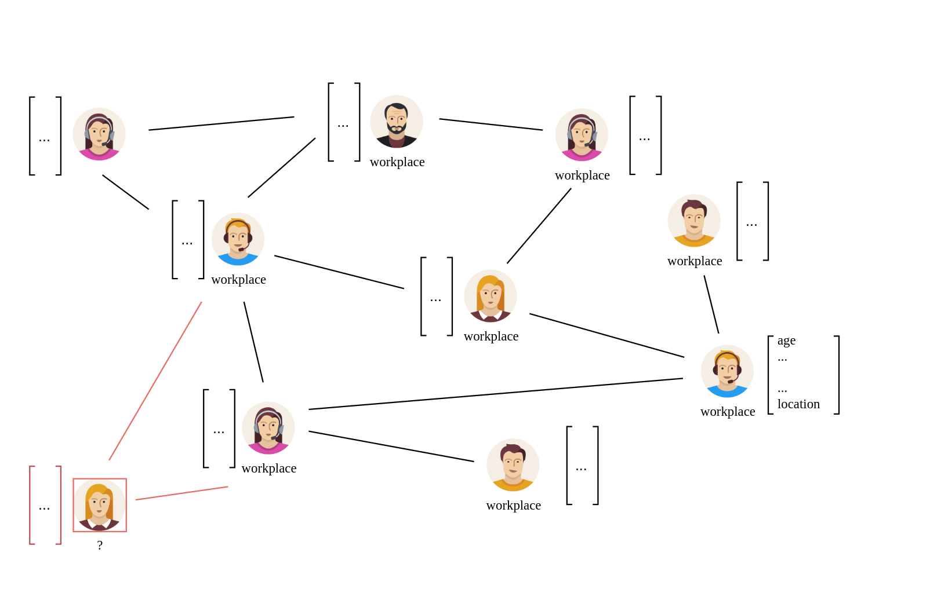
Graph Neural Networks
Inductive

Slide 31
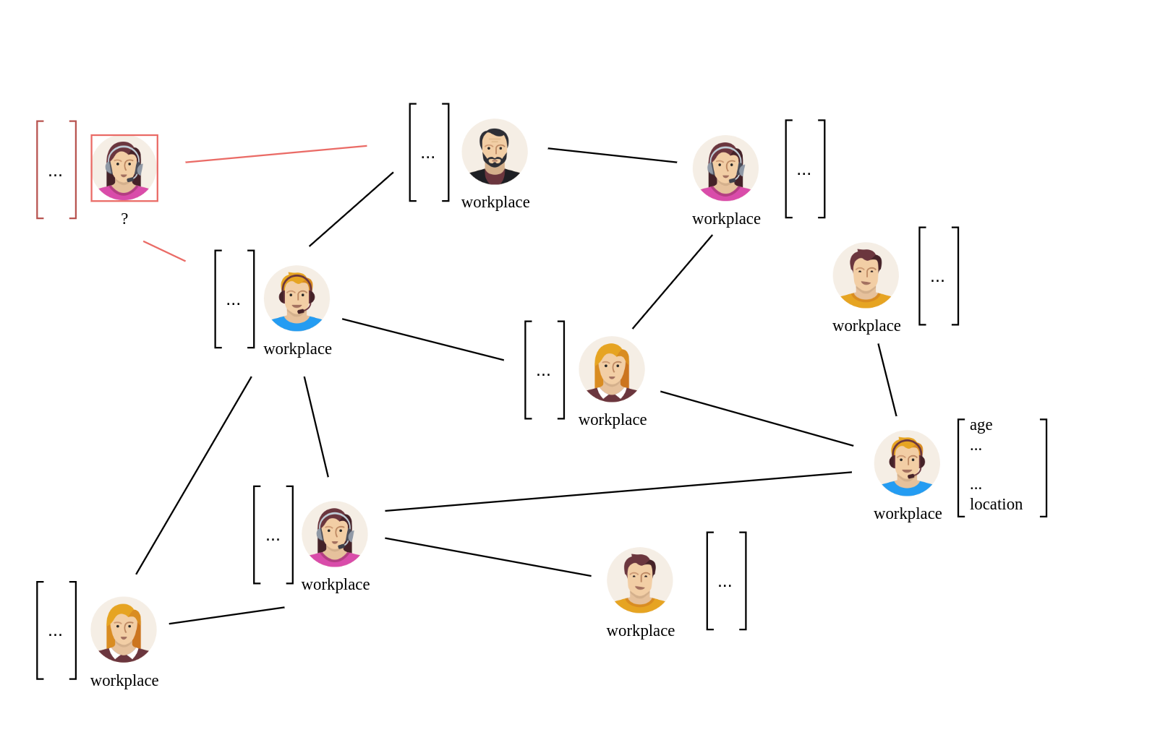
Graph Neural Networks
Inductive

Slide 32
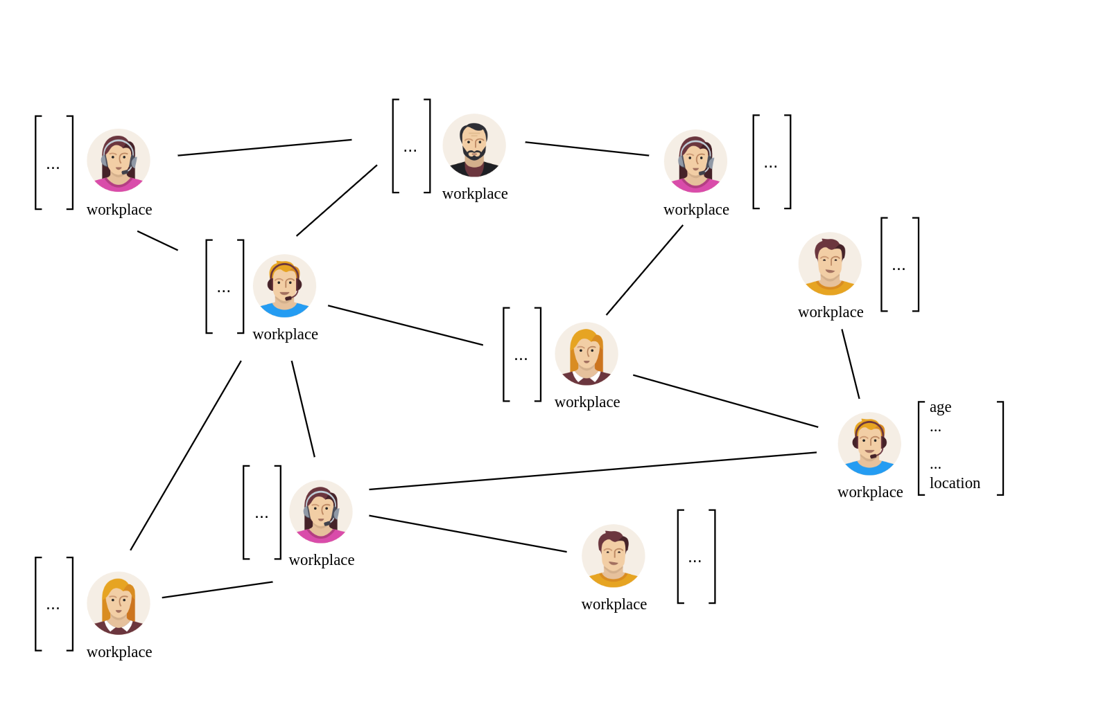
Graph Neural Networks
Inductive

Slide 33
Graph Neural Networks
Inductive
Train Graph

Slide 34
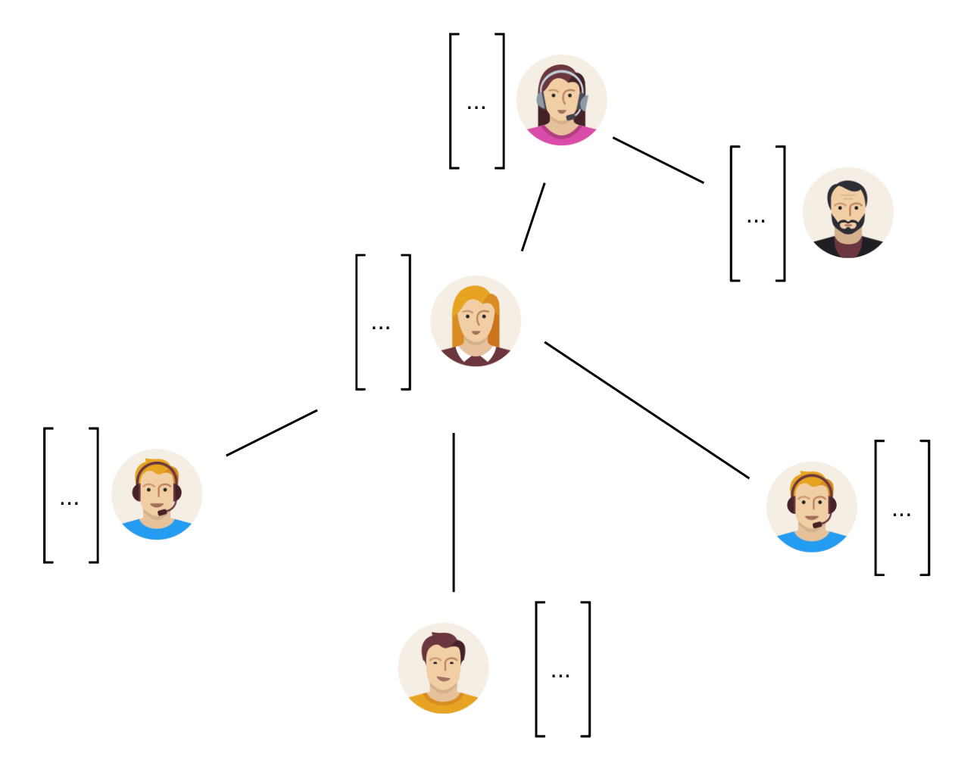
Graph Neural Networks
Inductive
Train Graph
Test Graph

Slide 35
Graph Neural Networks
Inductive
  Test set ( nodes and their features ) not known during training
    Train on one graph
    Test on another graph
  More realistic scenario
  Easy adjustable to new nodes without re-training full network

Slide 36
Link Stealing Attacks

Slide 37
Link Stealing Attacks
Scenario:
  GNN trained on graph to perform downstream task
  Attacker ( black box access )
Goal:
  Query GNN
  Use posteriors to infer whether two nodes are connected or not

Slide 38
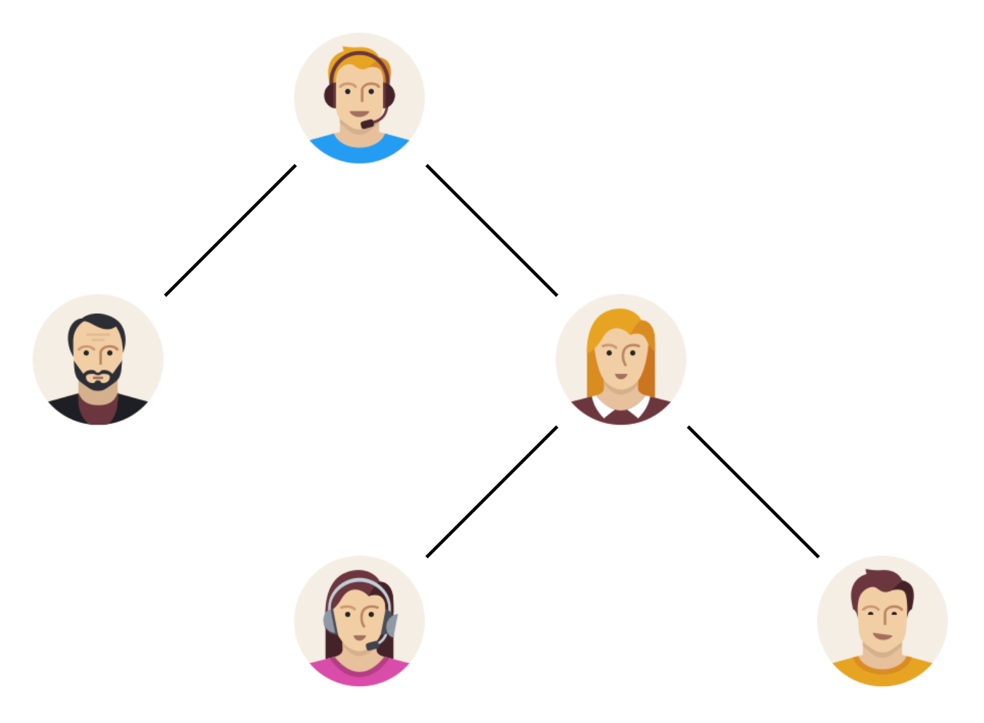
Link Stealing Attacks
Graph Neural Network
( target model )
train

Slide 39
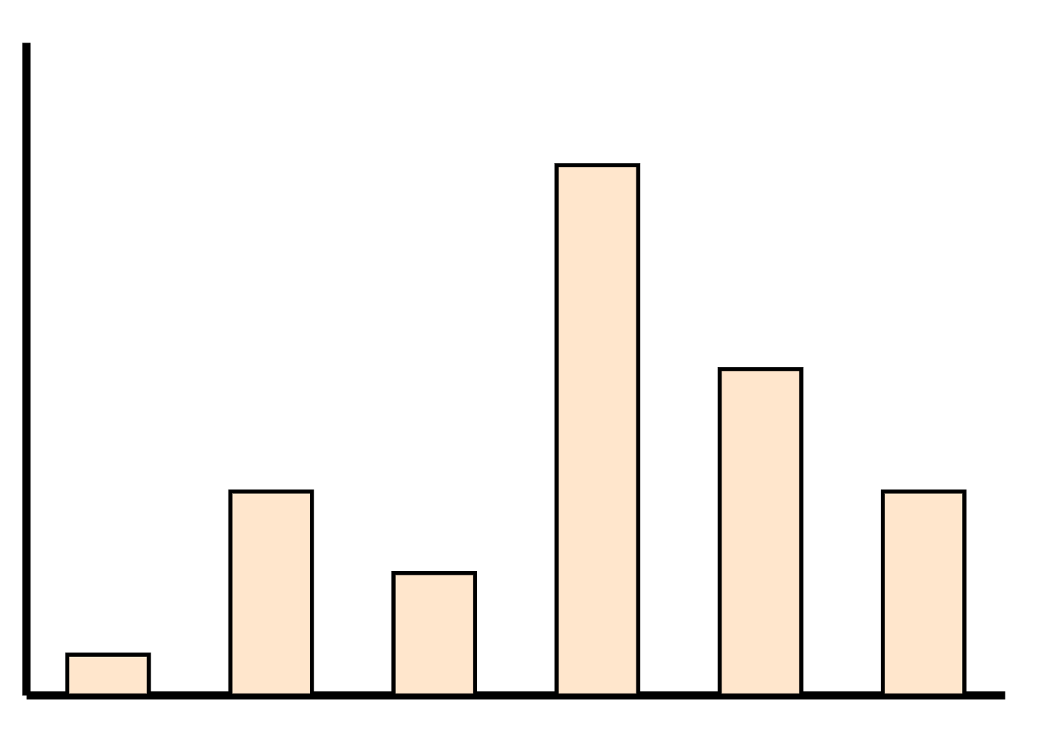
Link Stealing Attacks
Graph Neural Network
( target model )
query
output

Slide 40
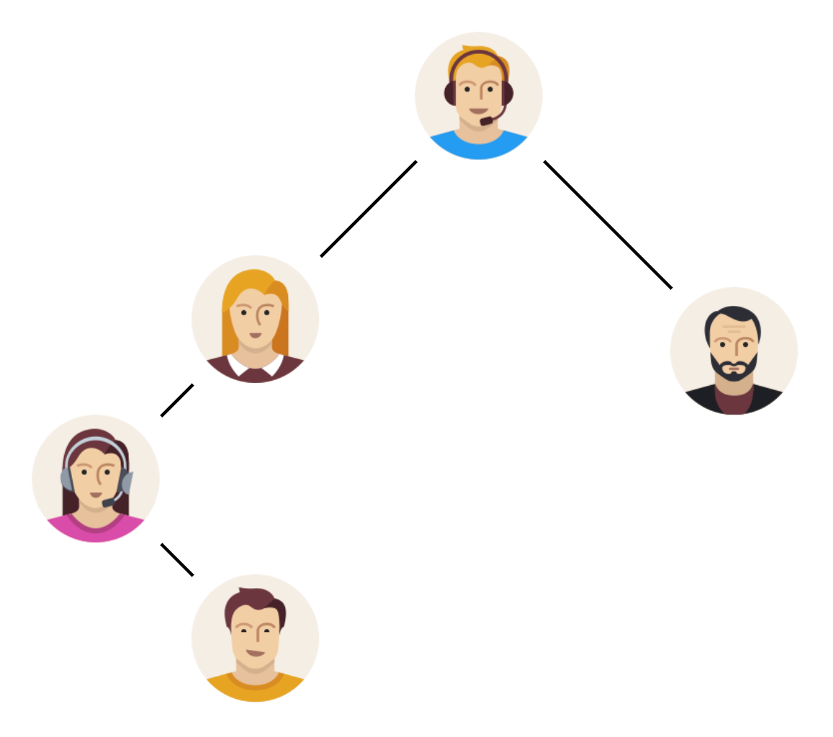
Link Stealing Attacks
Attackers graph

Slide 41
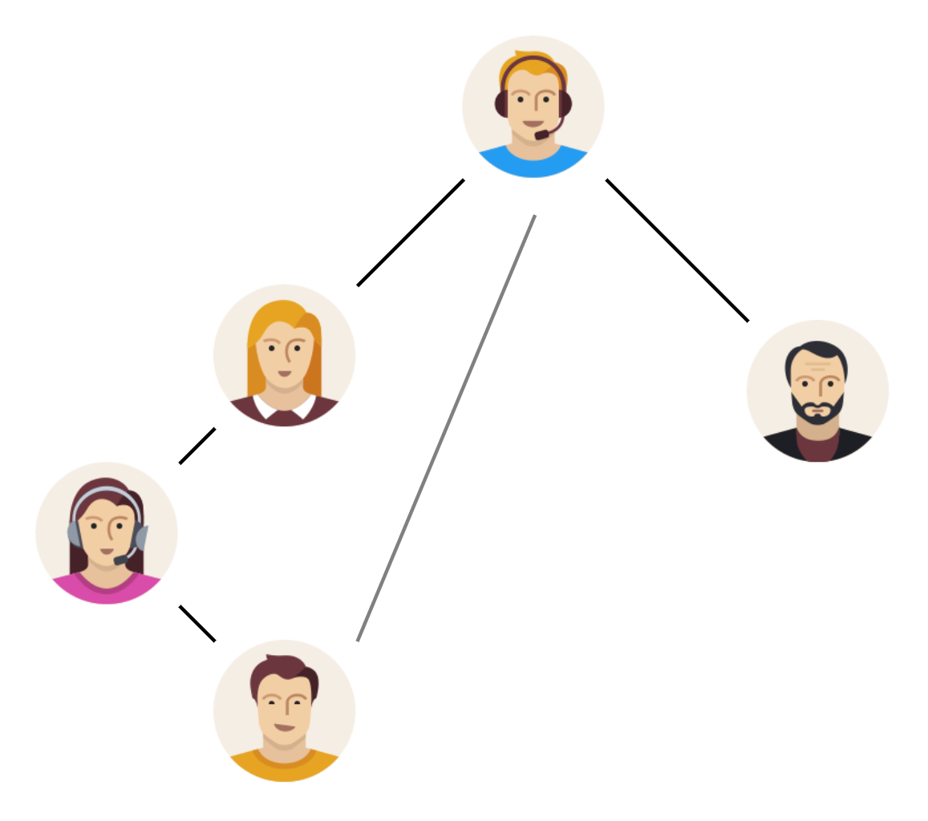
Link Stealing Attacks
Attackers graph with one possibly missing edge

Slide 42
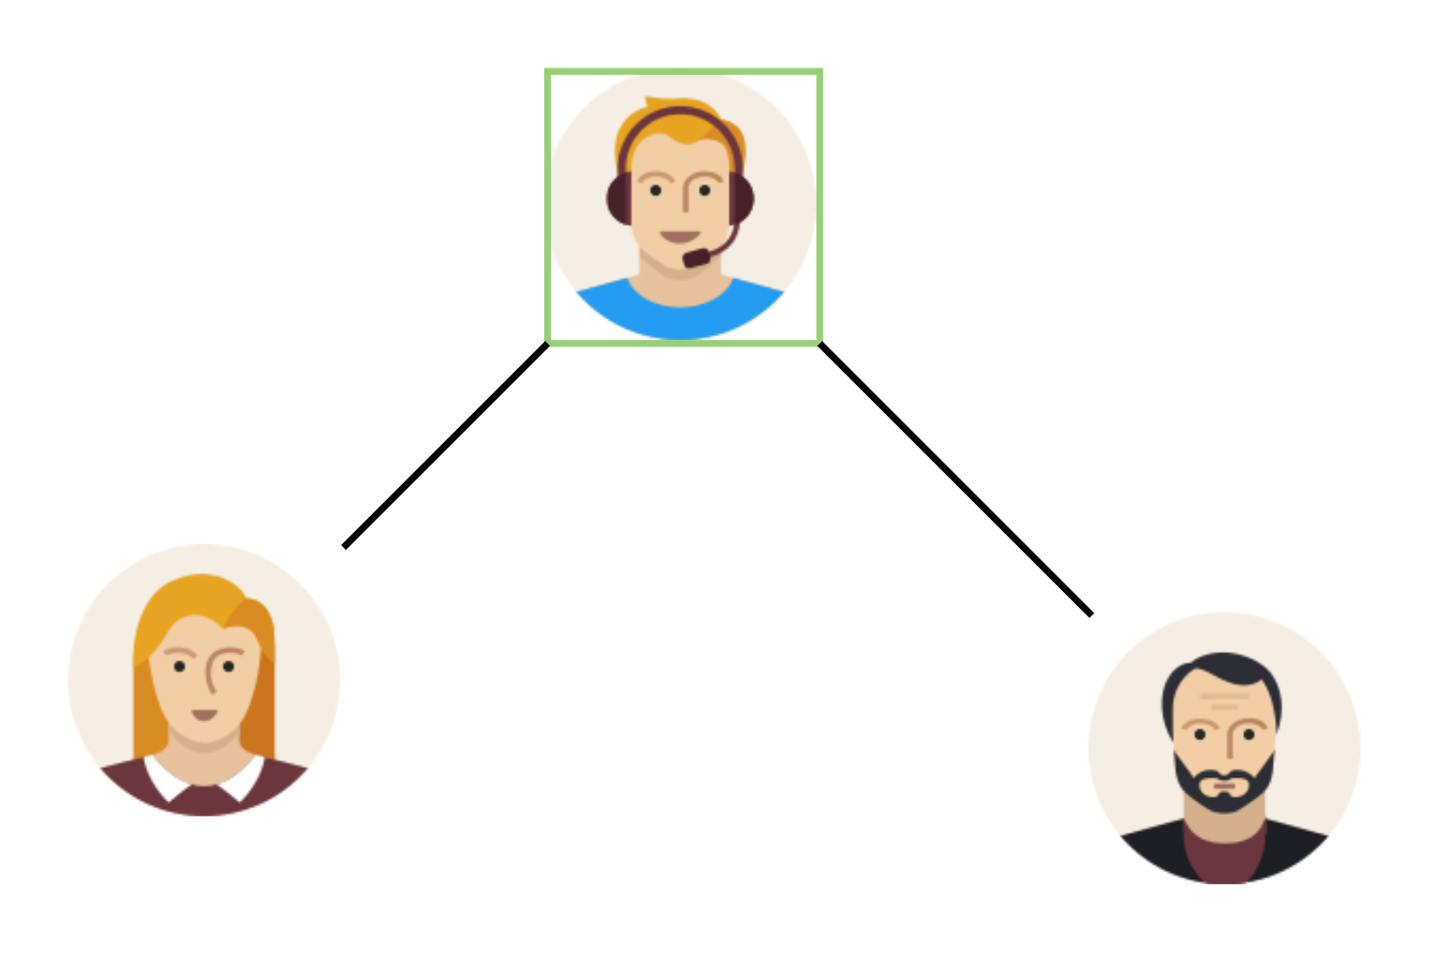
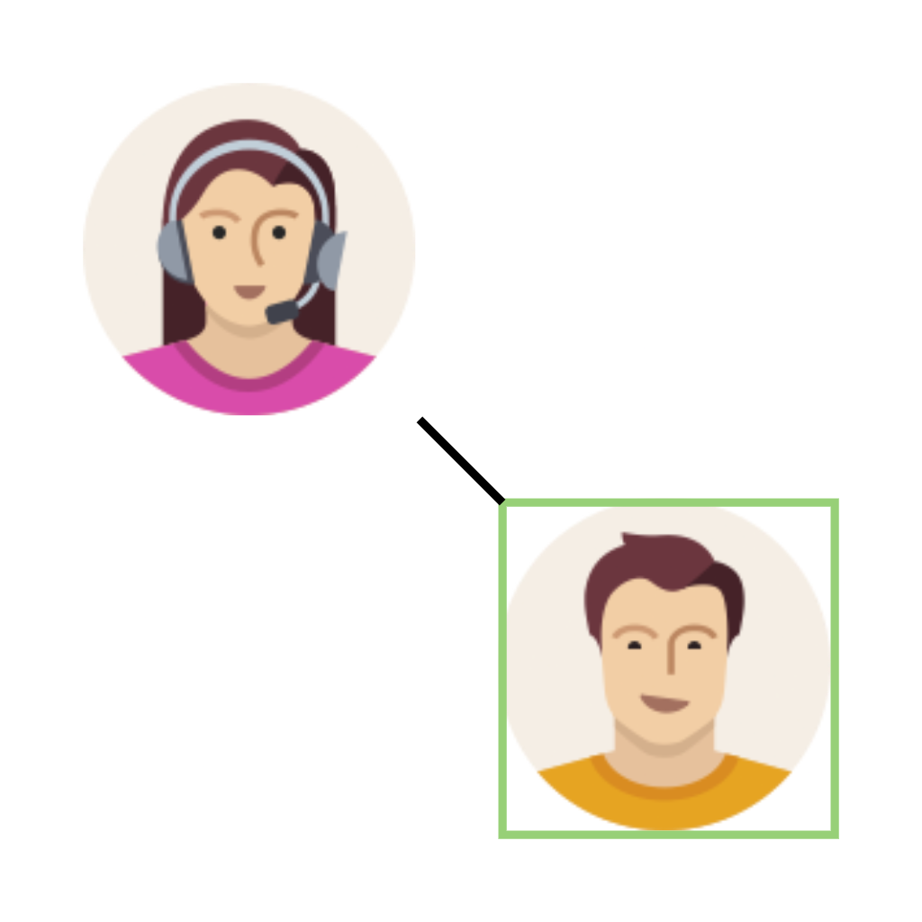
Link Stealing Attacks

Slide 43
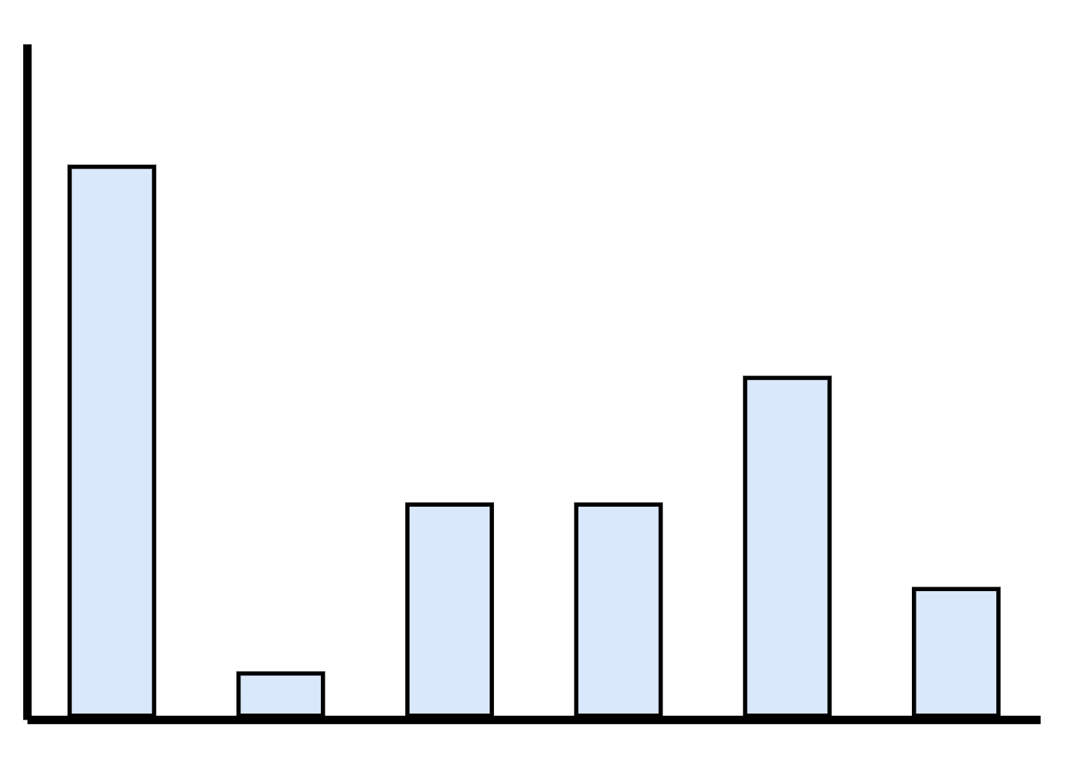
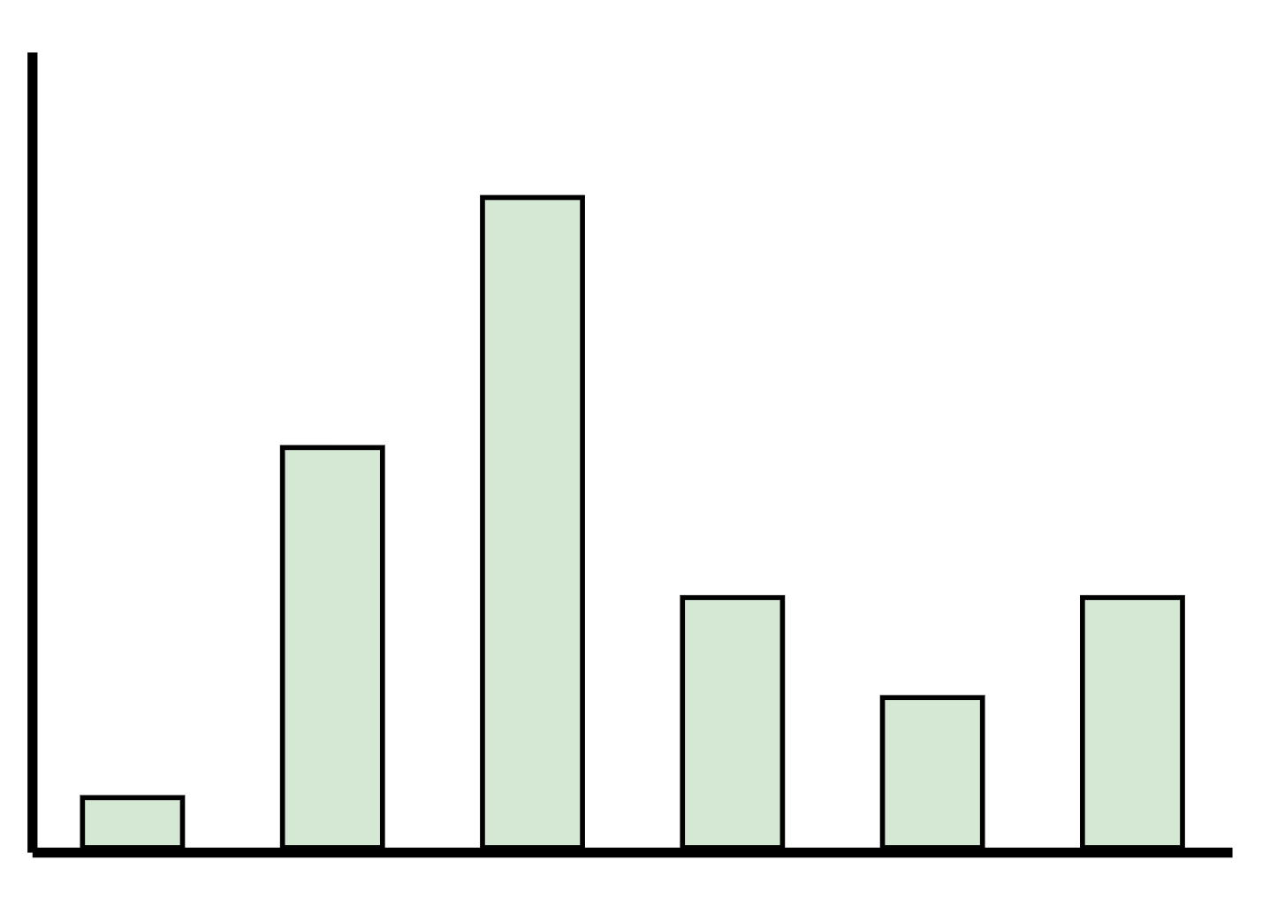
Link Stealing Attacks
GNN
( target model )
GNN
( target model )

Slide 44
Link Stealing Attacks

Slide 45
Link Stealing Attacks
[ 0.1, 0.2, 0.3, …, 0.9 ]
[ 0.9, 0.8, 0.7, …, 0.1 ]

Slide 46
Link Stealing Attacks
[ 0.1, 0.2, 0.3, …, 0.9 ]
[ 0.9, 0.8, 0.7, …, 0.1 ]

Slide 47
Link Stealing Attacks
[ 0.1, 0.2, 0.3, …, 0.9 ]
[ 0.9, 0.8, 0.7, …, 0.1 ]

Slide 48
Link Stealing Attacks
[ 0.1, 0.2, 0.3, …, 0.9 ]
[ Cosine, Manhattan, …, Euclidean ]
[ 0.9, 0.8, 0.7, …, 0.1 ]

Slide 49
Link Stealing Attacks
[ Cosine, Manhattan, …, Euclidean ]

Slide 50
Link Stealing Attacks
[ Cosine, Manhattan, …, Euclidean ]
MLP
( attacker model )

Slide 51
Link Stealing Attacks
[ Cosine, Manhattan, …, Euclidean ]
MLP
( attacker model )
Prediction whether nodes are connected or not

Slide 52
Experimental Setup

Slide 53
Experimental Setup

Slide 54
Interpretation of Results
On GraphSAGE

Slide 55
Interpret Results - GraphSAGE

Slide 56
Questions?

